Slide 1
Artificial neural network based Self-taught leaning for text classification
Lecture 14 -
1
Fei-Fei Li & Justin Johnson & Serena Yeung Lecture 14 - May 23, 2017

Slide 2
Contents
Introduction(what is self-taught learning)
Related work
Fine-tuning & Multitask Learning
Domain-adversarial training & Zero-shot Learning
Self-taught learning & Self-taught clustering
Self-taught learning
Architecture
Workflow
Text mining representation
Convolutional Neural Network for text
Datasets
Results
Lecture 14 -
2

Slide 3
Introduction
What is Self-taught Learning?
Self-taught Learning is one kind of Transfer learning
Lecture 14 -
3

Slide 4
Introduction
What is Self-taught Learning?
Self-taught Learning is one kind of Transfer learning
Self-taught Learning do Not assume:
The unlabeled data follows the same class labels or generative distribution as the labeled data
Lecture 14 -
4

Slide 5
Introduction
What is Self-taught Learning?
Self-taught Learning is one kind of Transfer learning
Self-taught Learning do Not assume:
The unlabeled data follows the same class labels or generative distribution as the labeled data
Self-taught Learning use:
Large number of unlabeled text randomly downloaded from the Internet to improve performance on a given text classification task
Lecture 14 -
5

Slide 6
Introduction
Related work:
 | Source Data (Not directly related to task)
Target Data |  | Labelled | Unlabeled
 | Labelled | Fine-tuning
 | Unlabeled
Lecture 14 -
6

Slide 7
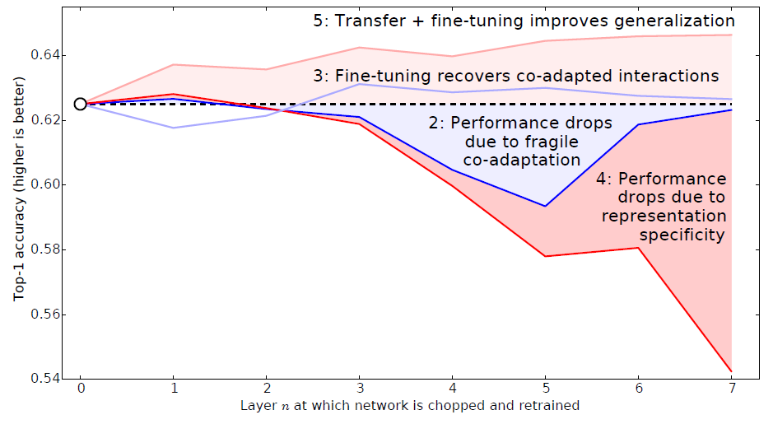
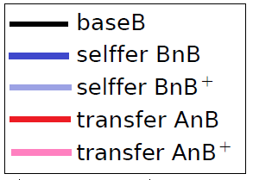
Introduction
Related work: Fine-tuning example
selffer network B3B:
the first 3 layers are copied from baseB and frozen.
transfer network A3B:
the first 3 layers are copied from baseA and frozen.
selffer network B3B+:
just like B3B, but where all layers learn.
transfer network A3B+:
just like A3B, but where all layers learn.
Jason Yosinski,Jeff Clune,Yoshua Bengio,HodLipson, “How transferable are features in deep neural networks?”, NIPS, 2014
Lecture 14 -
7

Slide 8
Introduction
Related work:
 | Source Data (Not directly related to task)
Target Data |  | Labelled | Unlabeled
 | Labelled | Fine-tuning Multitask Learning
 | Unlabeled
Lecture 14 -
8

Slide 9
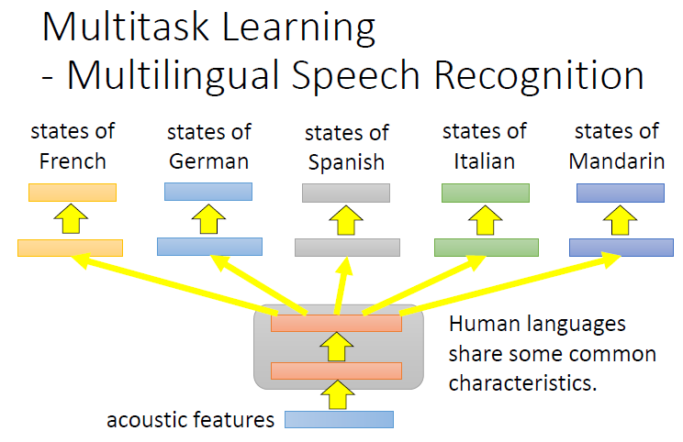
Introduction
Related work: Multi-task Learning
Daxiang Dong, HuaWu, Wei He, Dianhai Yu and Haifeng Wang, “Multi-Task Learning for Multiple Language Translation - ACL Anthology”, ACL, 2015
Lecture 14 -
9

Slide 10
Introduction
Related work:
 | Source Data (Not directly related to task)
Target Data |  | Labelled | Unlabeled
 | Labelled | Fine-tuning Multitask Learning
 | Unlabeled | Domain-adversarial training
Lecture 14 -
10

Slide 11
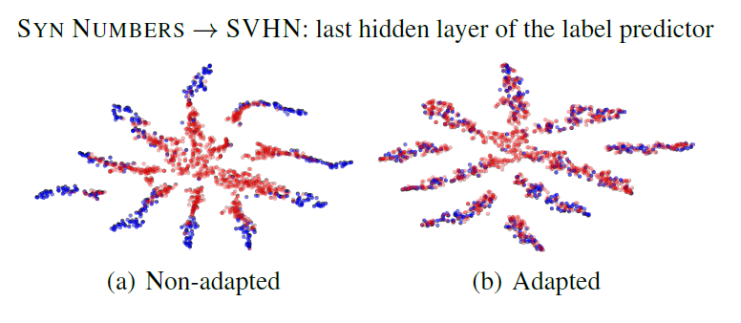
Introduction
Related work: Domain adversarial training
Blue points:
correspond to the source domain examples;
Red points:
correspond to the target domain;
The adaptation in the method makes the two distributions of features much closer.
Yaroslav Ganin, Victor Lempitsky, Unsupervised Domain Adaptation by Backpropagation, ICML, 2015
Hana Ajakan, Pascal Germain, Hugo Larochelle, François Laviolette, Mario Marchand,
Domain-Adversarial Training of Neural Networks, JMLR, 2016
Lecture 14 -
11

Slide 12
Introduction
Related work:
 | Source Data (Not directly related to task)
Target Data |  | Labelled | Unlabeled
 | Labelled | Fine-tuning Multitask Learning
 | Unlabeled | Domain-adversarial training Zero-shot Learning
Lecture 14 -
12

Slide 13
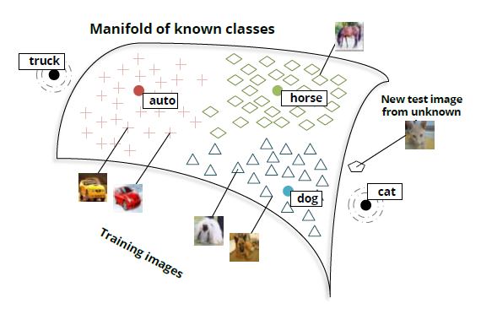
Introduction
Related work: Zero-shot Learning
1, Map each new testing image into a lower dimensional semantic word vector space.
2, Then, determine whether it is on the manifold
of seen images. If the image is ‘novel’, meaning not on the manifold, classify it with the help of
unsupervised semantic word vectors.
3, In this example, the unseen classes are truck and cat.
Richard Socher, Milind Ganjoo, Christopher D. Manning, Andrew Y. Ng, “Zero-Shot Learning Through Cross-Modal Transfer” NIPS,2013
Lecture 14 -
13

Slide 14
Introduction
Related work:
 | Source Data (Not directly related to task)
Target Data |  | Labelled | Unlabeled
 | Labelled | Fine-tuning Multitask Learning | Self-taught learning
 | Unlabeled | Domain-adversarial training Zero-shot Learning
Lecture 14 -
14

Slide 15
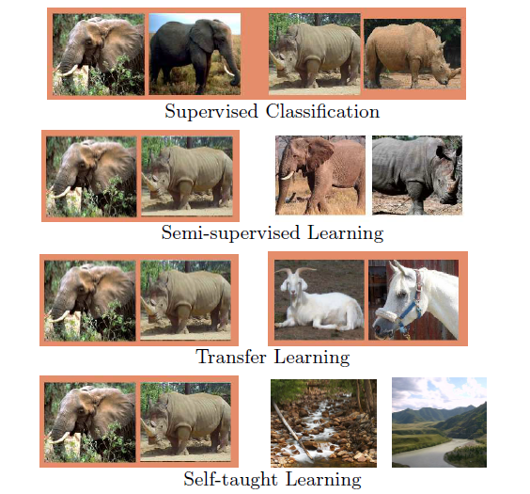
Introduction
Related work: Self-taught Learning
Supervised classification uses labeled examples of elephants and rhinos;
semi-supervised learning uses additional unlabeled examples of elephants and rhinos;
transfer learning uses additional labeled datasets;
self-taught learning just requires additional unlabeled images, such as ones randomly downloaded from the Internet.
Rajat Raina, Alexis Battle, Honglak Lee, Benjamin Packer, Andrew Y. Ng,"Self-taught Learning: Transfer Learning from Unlabeled Data", ICML,2007
Lecture 14 -
15

Slide 16
Introduction
Related work:
 | Source Data (Not directly related to task)
Target Data |  | Labelled | Unlabeled
 | Labelled | Fine-tuning Multitask Learning | Self-taught learning
 | Unlabeled | Domain-adversarial training Zero-shot Learning | Self-taught clustering
Lecture 14 -
16

Slide 17
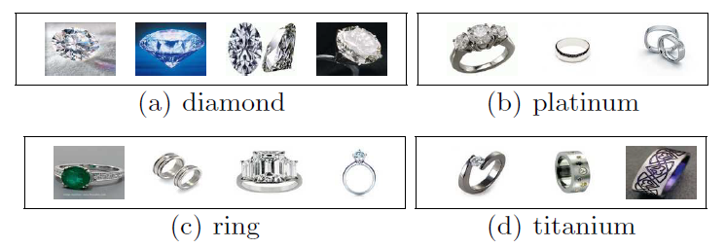
Introduction
Related work: Self-taught Clustering
diamond and ring share quite a lot of features about “diamond”;
ring and platinum share quite a lot of features about “platinum”;
platinum and titanium share quite a lot of features about “metal”.
In this situation, the auxiliary data can be used to help uncover a better data representation to benefit the target data set.
Lecture 14 -
17
Wenyuan Dai, Qiang Yang, Gui-Rong Xue, Yong Yu, “Self-taught Clustering ”, ICML,2008

Slide 18
Introduction
Related work:
 | Source Data (Not directly related to task)
Target Data |  | Labelled | Unlabeled
 | Labelled | Fine-tuning Multitask Learning | Self-taught learning
 | Unlabeled | Domain-adversarial training Zero-shot Learning | Self-taught clustering
Lecture 14 -
18

Slide 19
Document representation
How do we representing meaning of word
Definition: Meaning (Webster dictionary)
the idea that is represented by a word, phrase, etc.
the idea that a person wants to express by using words, signs, etc.
the idea that is expressed in a work of writing, art, etc.
Lecture 14 -
19

Slide 20
Document representation
Distributional Representation
Based on the hypothesis
that linguistic terms with similar distributions have similar meanings.
Typical models:
Latent Semantic Analysis (LSA)
probabilistic
LSA (pLSA)
Latent Dirichlet Allocation (LDA)
Lecture 14 -
20

Slide 21
Document representation
Problems with distributional representation
Vocabulary: The vocabulary requires careful design, most specifically in order to manage the size, which impacts the sparsity of the document representations.
Sparsity: Sparse representations are harder to model both for computational reasons (space and time complexity) and also for information reasons, where the challenge is for the models to harness so little information in such a large representational space.
Meaning: Discarding word order ignores the context, and in turn meaning of words in the document (semantics). Context and meaning can offer a lot to the model, that if modeled could tell the difference between the same words differently arranged (“this is interesting” vs “is this interesting”), synonyms (“old bike” vs “used bike”), and much more.
Lecture 14 -
21

Slide 22
Document representation
Distributed Representations
encode a document as a compact, dense
and lower dimensional vector with the semantic meaning of the document distributed along the dimensions of the vector
Typical models:
network-based distributed representation models
Lecture 14 -
22

Slide 23
Word representation models
Distributed representations of words in a vector space
can capture semantic meanings of words
help achieve better results in text analysis tasks
Popular word representation models
Word2Vec
Glove
NTM
FastText
Doc2Vec
Lecture 14 -
23

Slide 24
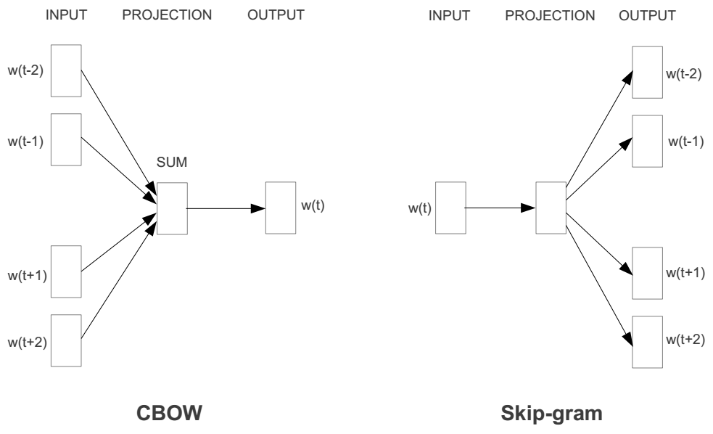
Word2Vector
Basic neural network models:
Continuous Bag of Word (CBOW): use a window of word to predict the middle word
Skip-gram (SG): use a word to predict the surrounding ones in window.
Lecture 14 -
24

Slide 25
Word2Vector
word2vec model:
1 Given a specific word “fox”
The quick brown fox jumps over the lazy dog
25

Slide 26
Word2Vector
word2vec model:
1 Given a specific word “fox”
2 Define nearby word by window size
The quick brown fox jumps over the lazy dog
26

Slide 27
Word2Vector
word2vec model:
1 Given a specific word “fox”
2 Define nearby word by window size
Window size = 1
The quick brown fox jumps over the lazy dog
27

Slide 28
Word2Vector
word2vec model:
1 Given a specific word “fox”
2 Define nearby word by window size
The quick brown fox jumps over the lazy dog
Window size = 2
28

Slide 29
Word2Vector
word2vec model:
1 Given a specific word “fox”
2 Define nearby word by window size
Window size = 1
The quick brown fox jumps over the lazy dog
Window size = 2
29

Slide 30
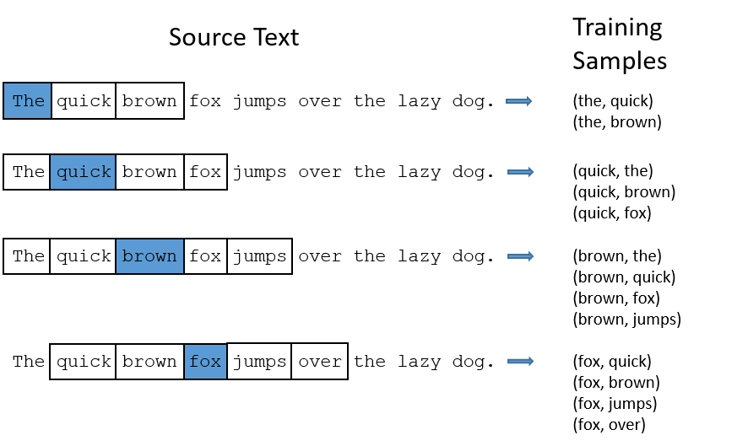
Word2Vector
Windowsize = 2 in this example
30

Slide 31
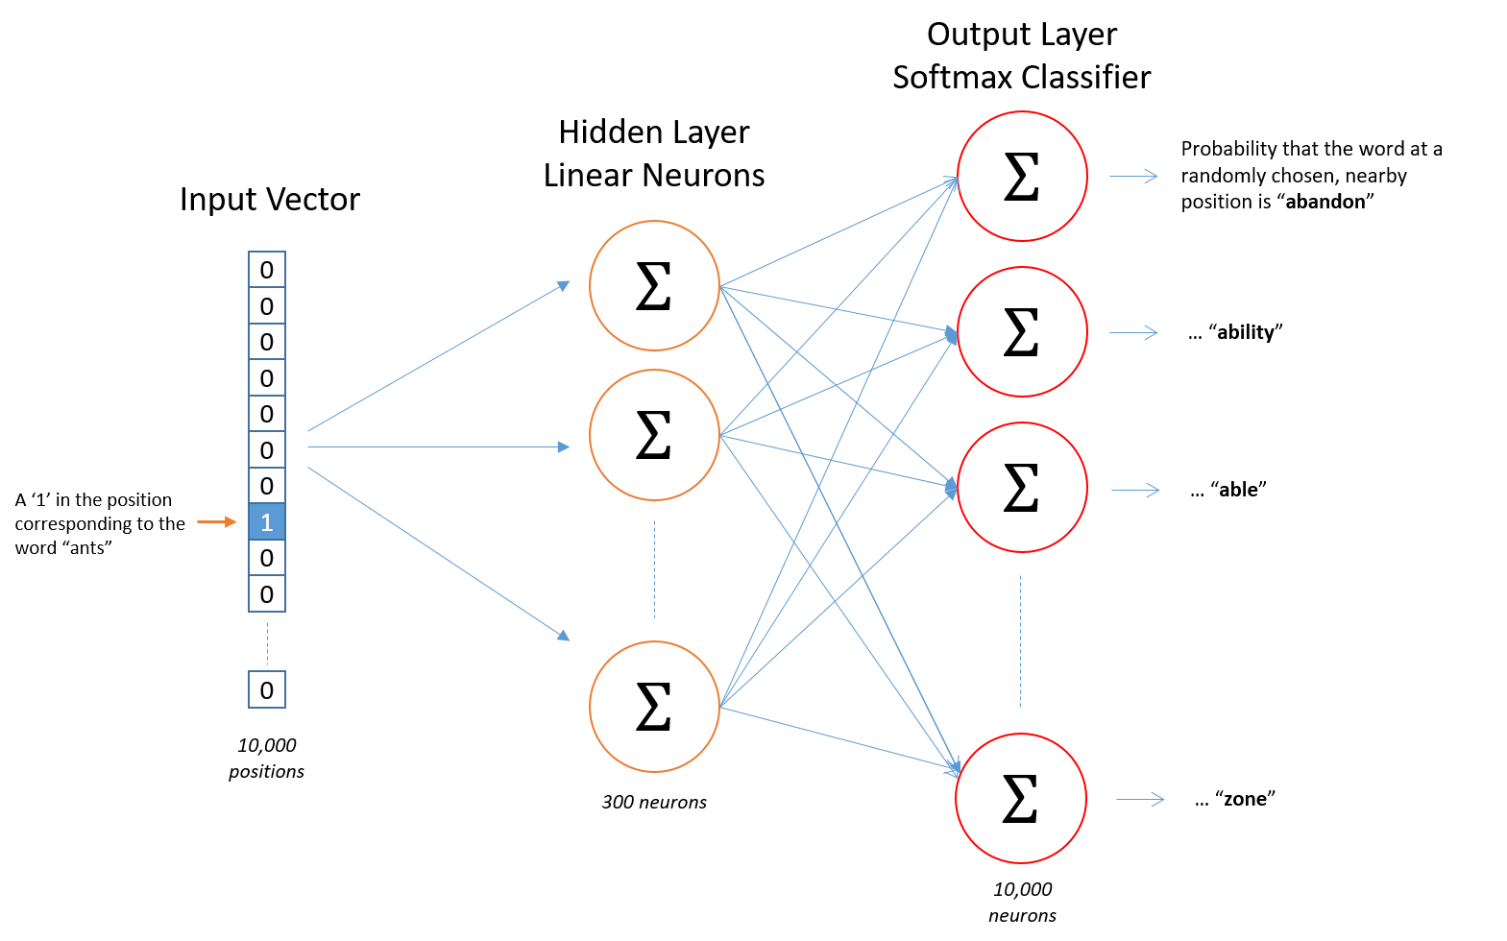
Word2Vector
word2vec model:
31

Slide 32
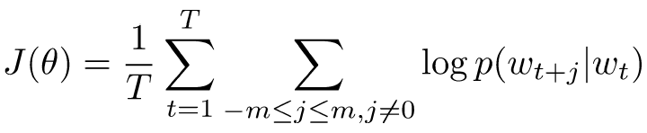
Word2Vector
Details of Word2vec
Predict surrounding words in a window of length m of every word.
Objective function: Maximize the log probability of any context word given the current center word:
Where represents all variables we optimize
32

Slide 33
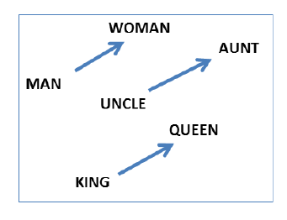
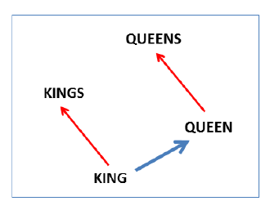
Word2Vector
Evaluation
Vector offsets for three word pairs.
illustrating the gender relation
singular/plural relation for
two words.
T. Mikolov, W.T. Yih, G. Zweig. Linguistic Regularities in Continuous Space Word Representations.
NAACL HLT 2013.

Slide 34
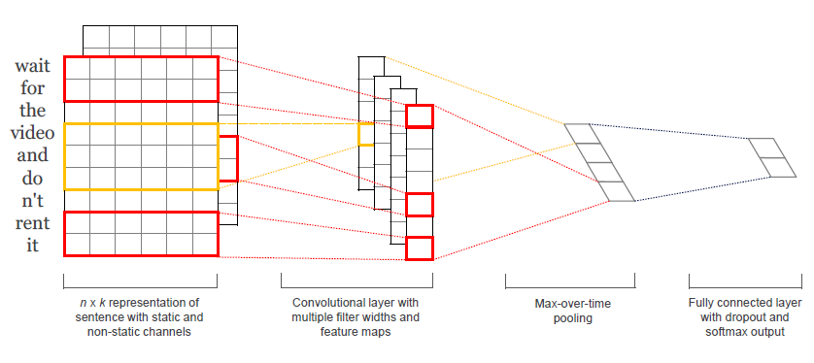
CNN for text classification
The Model
Kim, Y. (2014). Convolutional Neural Networks for Sentence Classification. EMNLP 2014

Slide 35
CNN for text classification
Steps:
First layers embeds words into low-dimensional vectors.
Next layer performs convolutions over the embedded word vectors using multiple filter sizes. For example, sliding over 3, 4 or 5 words at a time.
Max-pool the result of the convolutional layer into a long feature vector
Add dropout regularization, and classify the result using a softmax layer.

Slide 36
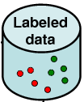

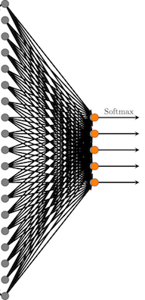

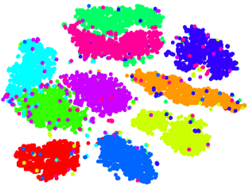
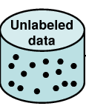

Self-taught learning diagram
Representation A learned from smaller labeled data
Classifier
Accuracy
Input is text
Feed classifier with representation of Labeled data from representation A
Unsupervised deep learning model
Feed classifier with representation of Labeled data from representation B
Input is text
Classifier
Higher Accuracy
Representation B learned from lager unlabeled data

Slide 37
Test and Datasets Structure
 | Target datasets | Source datasets (Has labels, but treated us unlabeled)
Test1 | T1 bbc news datasets | S1 extracted news data from Common crawl
Test2 | T2 Movie Review Datasets From Cornell | S2 Part of Movie review datasets From Stanford
Test3 | T3 part1 of Movie review datasets From Stanford | S3 part2 of Movie review datasets From Stanford
Test4 | T4 part1 of Amazon food review Datasets | S4 part2 of Amazon food review Datasets

Slide 38
Datasets: T1, T2, T3, T4
Datasets | Description | Labels & articles |  | Total articles
T1 | bbc news datasets | Business | 502 | 2,098
 |  | Entertainment | 364
 |  | Politics | 399
 |  | Sports | 497
 |  | Tech | 336
T2 | Movie Review Datasets From Cornell | Negative | 5,331 | 10,662
 |  | Positive | 5,331
T3 | part1 of Movie review datasets From Stanford | Negative | 4,500 | 9,000
 |  | Positive | 4,500
T4 | part1 of Amazon food review Datasets | Negative | 5,000 | 10,000
 |  | Positive | 5,000

Slide 39
Datasets: S1, S2, S3, S4
Datasets | Description | Labels & articles |  | Total
S1 | extracted news data from Common crawl | Business | 5,444 | 28,726
 |  | Entertainment | 4,011
 |  | Politics | 5,188
 |  | Sports | 6,138
 |  | Tech | 7,945
S2 | Part of Movie review datasets From Stanford | Negative | 12,500 | 25,000
 |  | Positive | 12,500
S3 | part2 of Movie review datasets From Stanford | Negative | 12,500 | 25,000
 |  | Positive | 12,500
S4 | part2 of Amazon food review Datasets | Negative | 30,000 | 60,000
 |  | Positive | 30,000

Slide 40
Working flow-Without transfer
Inputs are documents
Labelled Dataset
Document
Preprocessing
Word2Vec
Model
Removing noise (url, etc.)
Lowercasing
Tokenization (optional)

Slide 41
Working flow-Without transfer
Outputs are vectors for
each word
Inputs are documents
Labelled Dataset
Word
Embedding
Document
Preprocessing
Word2Vec
Model
Removing noise (url, etc.)
Lowercasing
Tokenization (optional)

Slide 42

Working flow-Without transfer
Outputs are vectors for
each word
Inputs are documents
Labelled Dataset
Word
Embedding
Document
Preprocessing
Word2Vec
Model
Removing noise (url, etc.)
Lowercasing
Tokenization (optional)
CNN
Classifier

Slide 43
Working flow-Without transfer
Outputs are vectors for
each word
Inputs are documents
Labelled Dataset
Word
Embedding
Document
Preprocessing
Word2Vec
Model
Removing noise (url, etc.)
Lowercasing
Tokenization (optional)
Classify Result
CNN
Classifier

Slide 44
Working flow-Transfer from unlabeled data
Labelled Dataset
Document
Preprocessing
Unlabeled Dataset
Removing noise (url, etc.)
Lowercasing
Tokenization (optional)

Slide 45
Working flow-Transfer from unlabeled data
Outputs are vectors for
each word
Inputs are documents
Labelled Dataset
Word
Embedding
Document
Preprocessing
Word2Vec
Model
Unlabeled Dataset
Removing noise (url, etc.)
Lowercasing
Tokenization (optional)

Slide 46
Working flow-Transfer from unlabeled data
Outputs are vectors for
each word
Inputs are documents
Labelled Dataset
Word
Embedding
Document
Preprocessing
Word2Vec
Model
Unlabeled Dataset
Removing noise (url, etc.)
Lowercasing
Tokenization (optional)
CNN
Classifier

Slide 47
Working flow-Transfer from unlabeled data
Outputs are vectors for
each word
Inputs are documents
Labelled Dataset
Word
Embedding
Document
Preprocessing
Word2Vec
Model
Unlabeled Dataset
Removing noise (url, etc.)
Lowercasing
Tokenization (optional)
Classify Result
CNN
Classifier

Slide 48
Results
S1 dataset improve T1 dataset classification
Word2vec
model
T1
Word2vec
model
S1
Accuracy on
T1
Accuracy on
S1
(has label, but was treated as unlabeled)
Before
Transfer 0.947 0.573
(classifier A)
Words in vectors
Words in vectors
CNN Model
CNN Model
Trained classifier A
Trained classifier B
48

Slide 49
Results
S1 dataset improve T1 dataset classification
Word2vec
model
T1
Word2vec
model
S1
Accuracy on
T1
Accuracy on
S1
(has label, but was treated as unlabeled)
Before
Transfer 0.947 0.573
(classifier A)
Words in vectors
Words in vectors
CNN Model
CNN Model
After
Transfer 0.971 0.752
(classifier B)
Trained classifier A
Trained classifier B
49

Slide 50
Results
S2 dataset improve T2 dataset classification
Word2vec
model
T2
Word2vec
model
S2
Accuracy on
T2
Accuracy on
S2
(has label, but was treated as unlabeled)
Before
Transfer 0.718 0.622
(classifier A)
Words in vectors
Words in vectors
CNN Model
CNN Model
Trained classifier A
Trained classifier B
50

Slide 51
Results
S2 dataset improve T2 dataset classification
Word2vec
model
T2
Word2vec
model
S2
Accuracy on
T2
Accuracy on
S2
(has label, but was treated as unlabeled)
Before
Transfer 0.718 0.622
(classifier A)
Words in vectors
Words in vectors
CNN Model
CNN Model
After
Transfer 0.764 0.656
(classifier B)
Trained classifier A
Trained classifier B
51

Slide 52
Results
S3 dataset improve T3 dataset classification
Word2vec
model
T3
Word2vec
model
S3
Accuracy on
T3
Accuracy on
S3
(has label, but was treated as unlabeled)
Before
Transfer 0.832 0.811
(classifier A)
Words in vectors
Words in vectors
CNN Model
CNN Model
Trained classifier A
Trained classifier B
52

Slide 53
Results
S3 dataset improve T3 dataset classification
Word2vec
model
T3
Word2vec
model
S3
Accuracy on
T3
Accuracy on
S3
(has label, but was treated as unlabeled)
Before
Transfer 0.832 0.811
(classifier A)
Words in vectors
Words in vectors
CNN Model
CNN Model
After
Transfer 0.843 0.833
(classifier B)
Trained classifier A
Trained classifier B
53

Slide 54
Results
S4 dataset improve T4 dataset classification
Word2vec
model
T4
Word2vec
model
S4
Accuracy on
T4
Accuracy on
S4
(has label, but was treated as unlabeled)
Before
Transfer 0.876 0.823
(classifier A)
Words in vectors
Words in vectors
CNN Model
CNN Model
Trained classifier A
Trained classifier B
54

Slide 55
Results
S4 dataset improve T4 dataset classification
Word2vec
model
T4
Word2vec
model
S4
Accuracy on
T4
Accuracy on
S4
(has label, but was treated as unlabeled)
Before
Transfer 0.876 0.823
(classifier A)
Words in vectors
Words in vectors
CNN Model
CNN Model
After
Transfer 0.887 0.856
(classifier B)
Trained classifier A
Trained classifier B
55

Slide 56
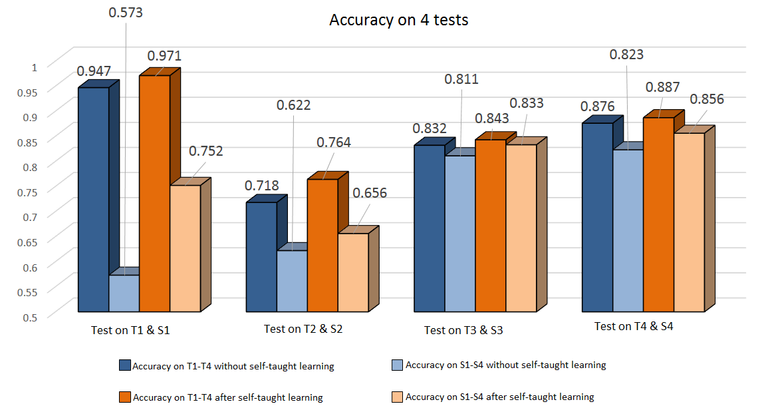
Result
56

Slide 57
Conclusion
Features learned from unlabeled data enhanced the classification of labelled data

Slide 58
Conclusion
Features learned from unlabeled data enhanced the classification of labelled data
Classifier trained from small volume labelled data is better when using features learned from unlabeled data

Slide 59
Conclusion
Features learned from unlabeled data enhanced the classification of labelled data
Classifier trained from small volume labelled data is better when using features learned from unlabeled data
Trained classifier can be used to assign labels for unlabeled data

Slide 60
Conclusion
Features learned from unlabeled data enhanced the classification of labelled data
Classifier trained from small volume labelled data is better when using features learned from unlabeled data
Trained classifier can be used to assign labels for unlabeled data
Part of unlabeled data has labels, which can be used to train a better classifier.

Slide 61
References
Raina, Rajat, et al. "Self-taught learning: transfer learning from unlabeled data." Proceedings of the 24th international conference on Machine learning. ACM, 2007.
Krizhevsky, Alex, Ilya Sutskever, and Geoffrey E. Hinton. "Imagenet classification with deep convolutional neural networks." Advances in neural information processing systems. 2012.
Kalchbrenner, Nal, Edward Grefenstette, and Phil Blunsom. "A convolutional neural network for modelling sentences." arXiv preprint arXiv:1404.2188 (2014).
Mikolov, Tomas, Wen-tau Yih, and Geoffrey Zweig. "Linguistic regularities in continuous space word representations." Proceedings of the 2013 Conference of the North American Chapter of the Association for Computational Linguistics: Human Language Technologies. 2013.
Mikolov, Tomas, et al. "Efficient estimation of word representations in vector space." arXiv preprint arXiv:1301.3781 (2013).
Turian, Joseph, Lev Ratinov, and Yoshua Bengio. "Word representations: a simple and general method for semi-supervised learning." Proceedings of the 48th annual meeting of the association for computational linguistics. Association for Computational Linguistics, 2010.
Kim, Yoon. "Convolutional neural networks for sentence classification." arXiv preprint arXiv:1408.5882 (2014).
Lecture 14 -
61

